Slide 1
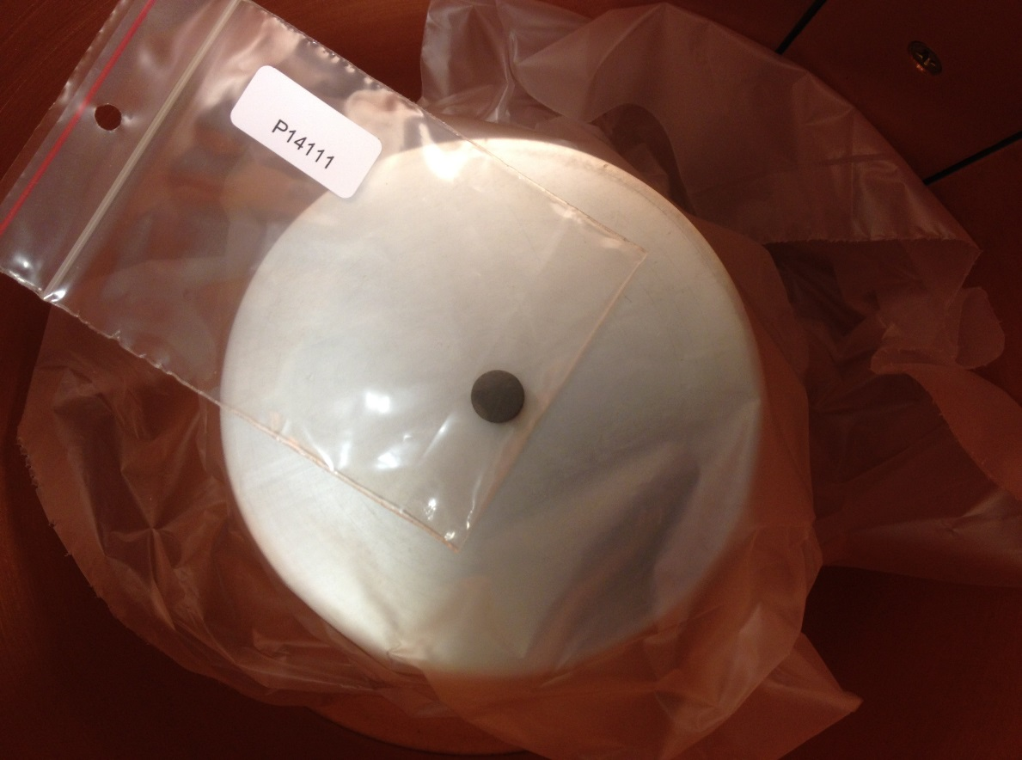
Gamma spectrometric measurements of uranium isotopic composition:
-Accuracy and precision
H. Ramebäck, P. Lagerkvist, S. Holmgren, S. Jonsson, B. Sandström, A. Tovedal, A. Vesterlund, T. Vidmar#, J. Kastlander
FOI CBRN Defence and Security, Sweden
# SCK-CEN, Belgium
Presentation@GAMMASPEC 2016

Slide 2
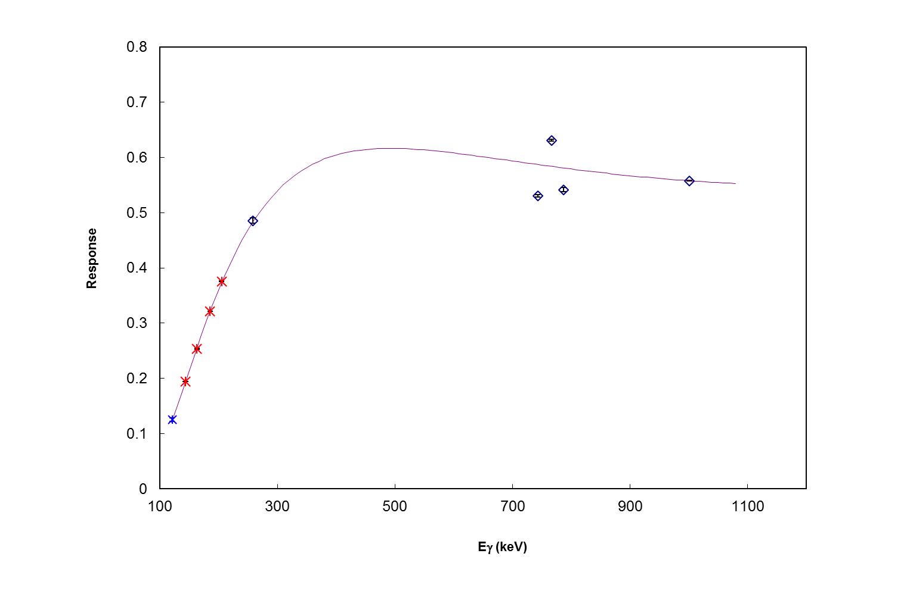
The problem

Slide 3
Agenda
Gamma spectrometric measurements of uranium
Theory
Experimental
True coincidence summation
Results
Conclusions

Slide 4
Gamma spectrometry of uranium isotopics
In this presention the use of the ’high energy’ region is considered, i.e. 120-1001 keV!
In general, GS is a fast and ’non-destructive’ measurement method
However, somewhat high uncertainties:
-U_{f235}=10-20%, k=2, in this work
Dedicated commercial softwares available, but in this work an in house algorithm was used

Slide 5
Theory: Isotopics using HRGS
The efficiency:
A_{i}
Isotope ratio:
Count rate at E_{γ,j} from measurement!
The relative efficiency:
Isotope ratio(s) as measurand(s)!
I and λ from DDEP!
Empirical response fcn:
-Fit R_{i} och c₁-c₅ by means of the least square method
Uncertainties using the Jackknife method!

Slide 6
Theory
The isotope ratios R_{i}:
-R₂₃₄=n₂₃₄/n₂₃₈
-R₂₃₅=n₂₃₄/n₂₃₈
The abundance of ²³⁵U:
-f₂₃₅=R₂₃₅/ΣR_{i} (Observe: R₂₃₈=1)
where ΣR_{i}=1+R₂₃₄+R₂₃₅
Measurands!

Slide 7
Experimental
Samples:
Three LEU samples and IRMM-184 (NU CRM):
-One LEU and IRMM-184 as acid solutions (measured in the standard geometry: 60 mL sample container)
-Two LEU as UO₂ pellets
Detector:
-p-type HPGe (~75×75 mm)
-Semi-empirical calibration: possible to calculate efficiencies for non-std geometries, as well as different correction factors
Measurements directly on detector encap➔True coincidence summations!?
TCS correction factors calculated using EFFTRAN and VGSL

Slide 8
True coincidence summation (TCS)
Gamma photons emitted within the time resolution of the detector system:
➔Count losses…
Depends on the geometry (solid
angle):
-Detector size
-Sample size
-Detector-to-sample
distance
Also detector type…
The effect cancels out when the sample is far away from the detector (distant geos), but that will reduce the sensitivity, resulting in much longer counting times!
(In this work: reducing the TCS on 258 keV from ^{234m}Pa ’enough’ would require a distance which reduces the efficiency by about a factor of 15…)
Classical example:

Slide 9
TCS: Uranium
No significant TCS for ²³⁵U in this work
Some peaks from ²³⁸U (^{234m}Pa!) largely affected
258 keV the most affected peak!!!
This peak is the most important one for uranium isotopics (in particular for low enrichments) when using the ’high energy region’, and a systematic effect for this peak will result in a sytematic effect for the enrichment (with about the same factor)

Slide 10
The correction factor
Adding the correction factor for TCS, k_{TCS.i,Ej}, to the measurement model:

Slide 11
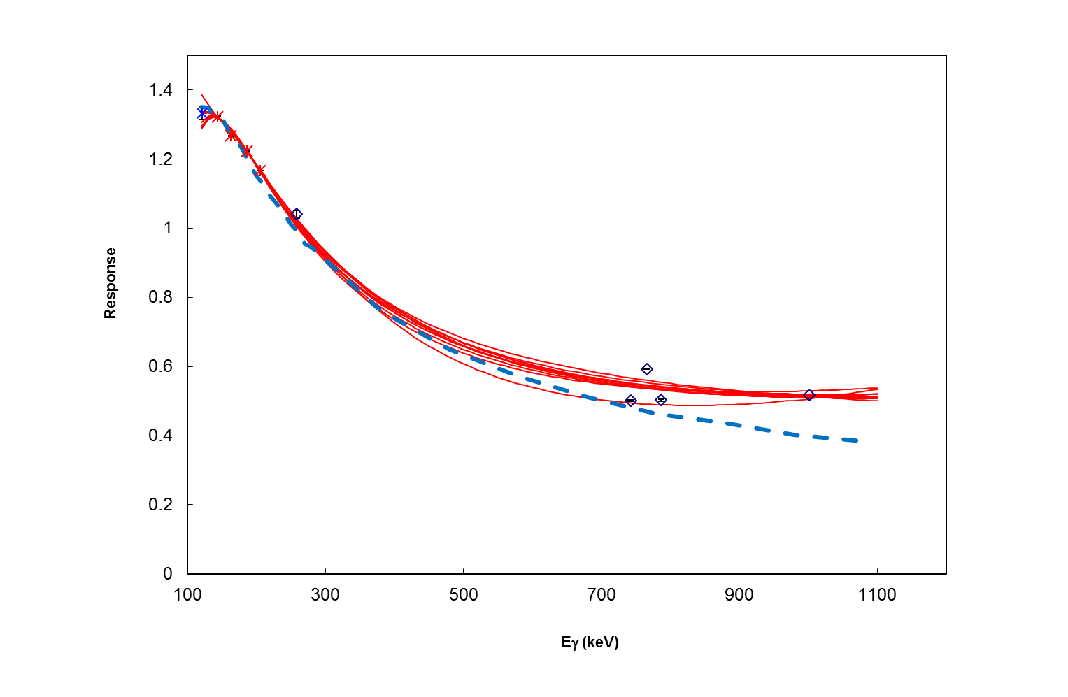
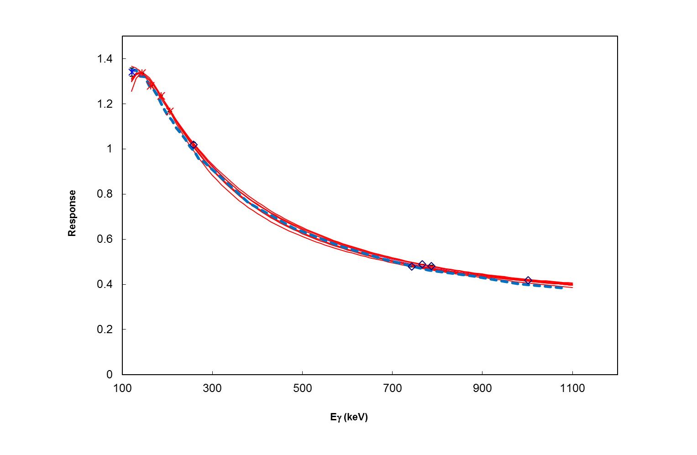
Results: LEU dissolved in the ’std-geo’
Calculated response for the particular geometry
!!!
After correction➔

Slide 12
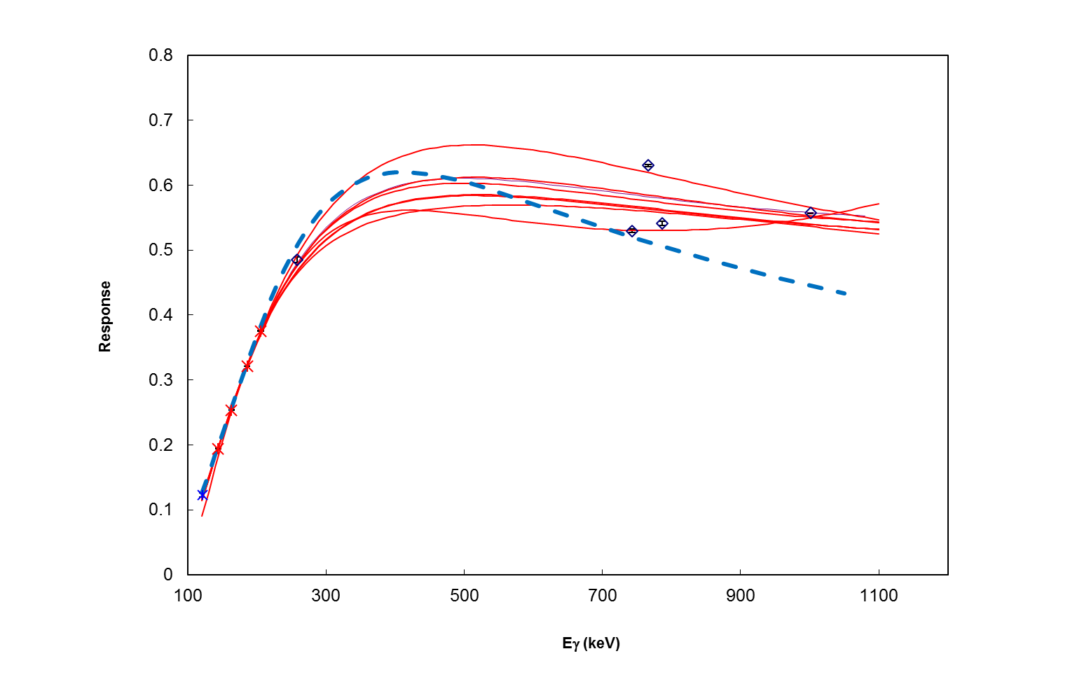
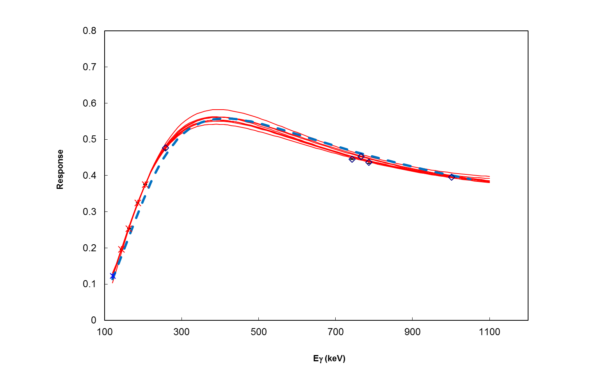
Results: LEU as an uranium pellet
Calculated response for the particular geometry
!!!
After correction➔

Slide 13
Results: ²³⁵U

Slide 14
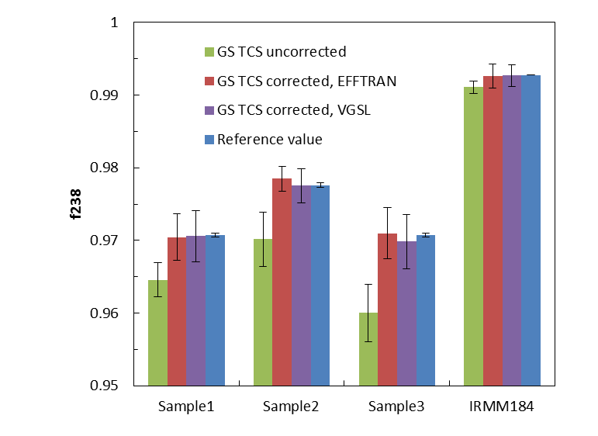
Resultat: ²³⁸U

Slide 15
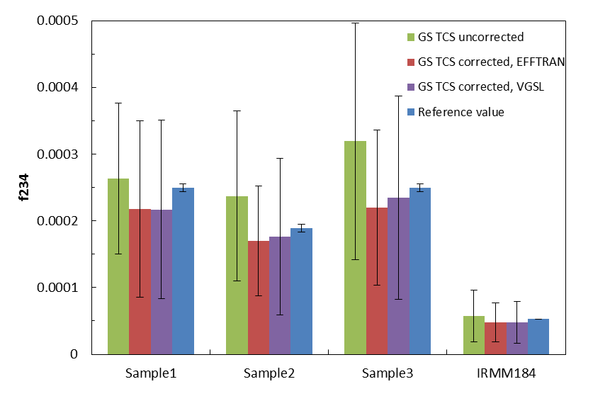
Resultat: ²³⁴U

Slide 16
Conclusions
Without TCS correction the enrichments of uranium samples were overestimated (maximum about 40% in this work) using the detector and geometries as in this work
However, corrections resulted in excellent agreement with reference values (MS and a ref mtrl), i.e. no significant deviations
Maximum bias was <4%, and U_{f235}=10% (k=2), for the LEU materials

Slide 17
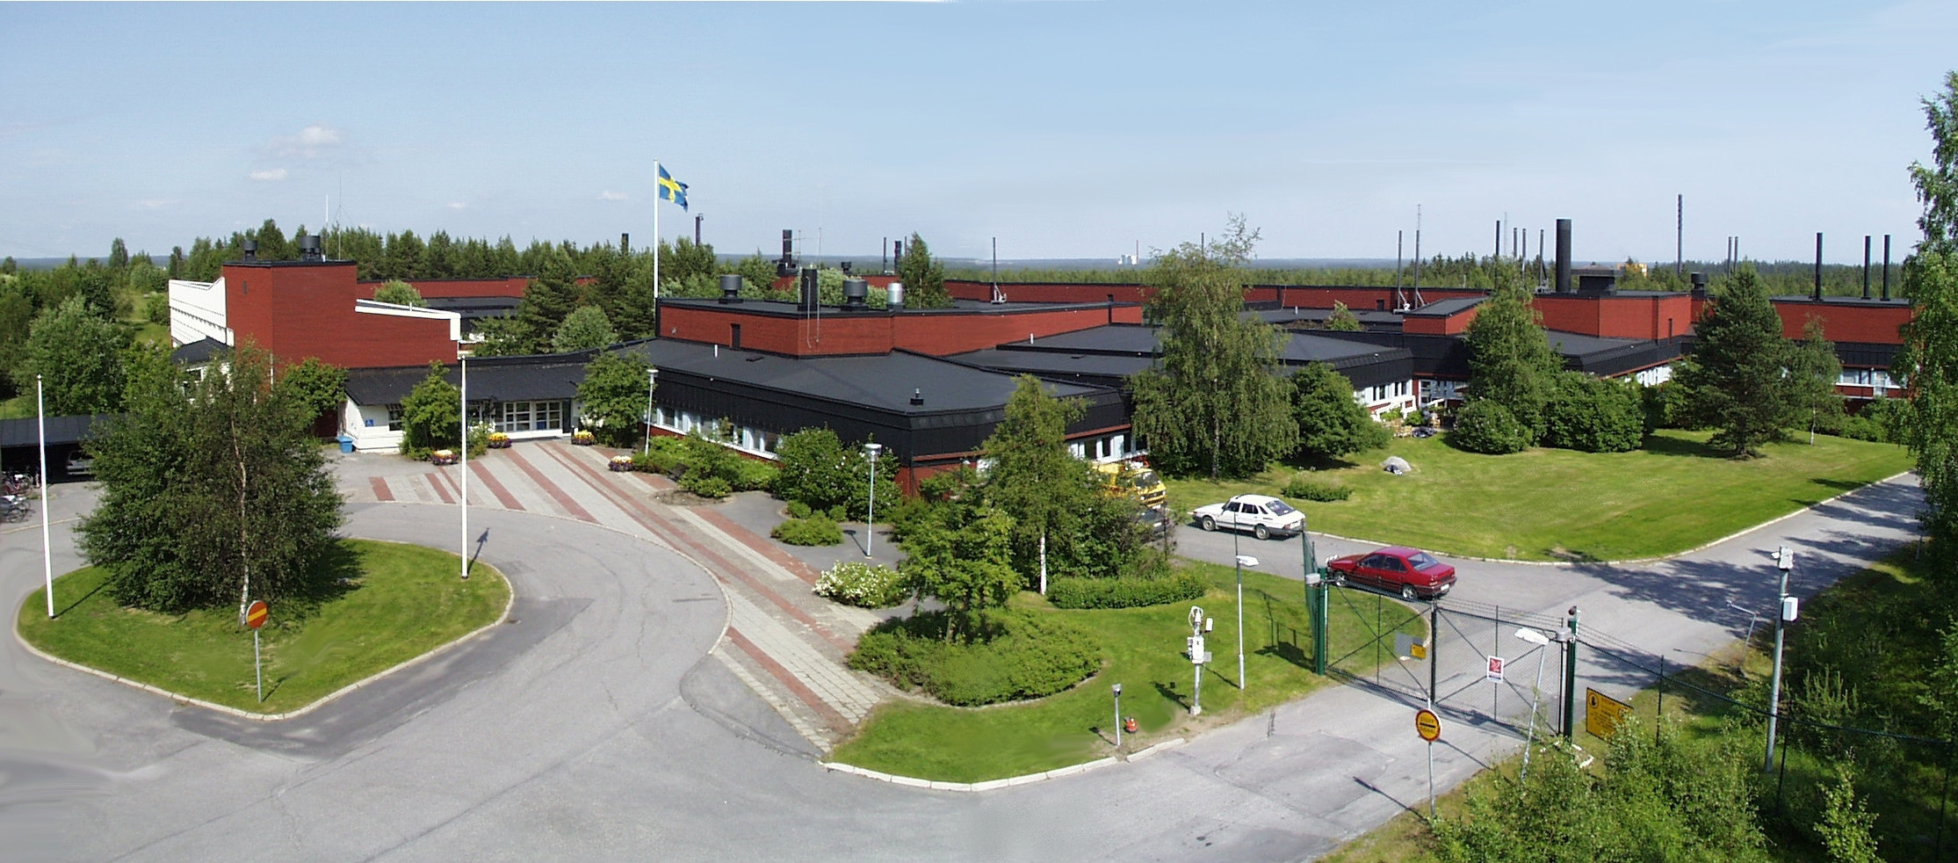
FOI CBRN Defence and Security, Umeå
?

Slide 18
Complementary information

Slide 19
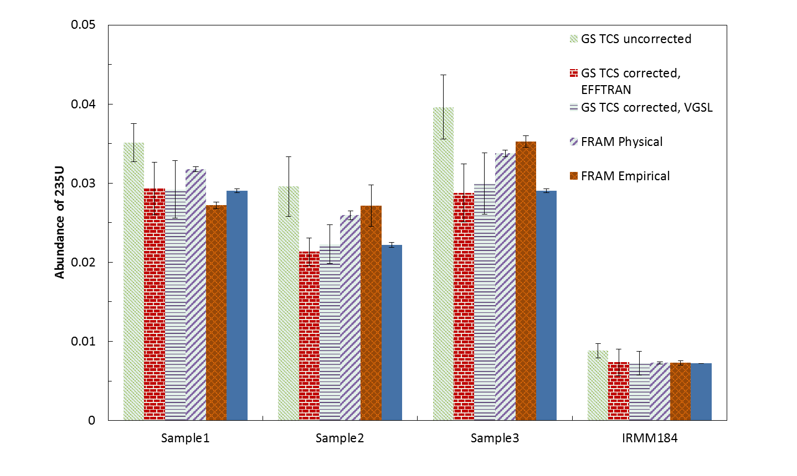
²³⁵U abundance (FRAM evaluations included):

