Slide 1
Quality assurance of a characterised Ge-detector used for various geometries
(mathematical efficiency calibration)
Asser Nyander Poulsen
Special Adviser, Ph.D.
apo@sis.dk
Strålebeskyttelse i Sundhedsstyrelsen (SIS)
Knapholm 7
2730 Herlev, Denmark
www.sis.dk

Slide 2
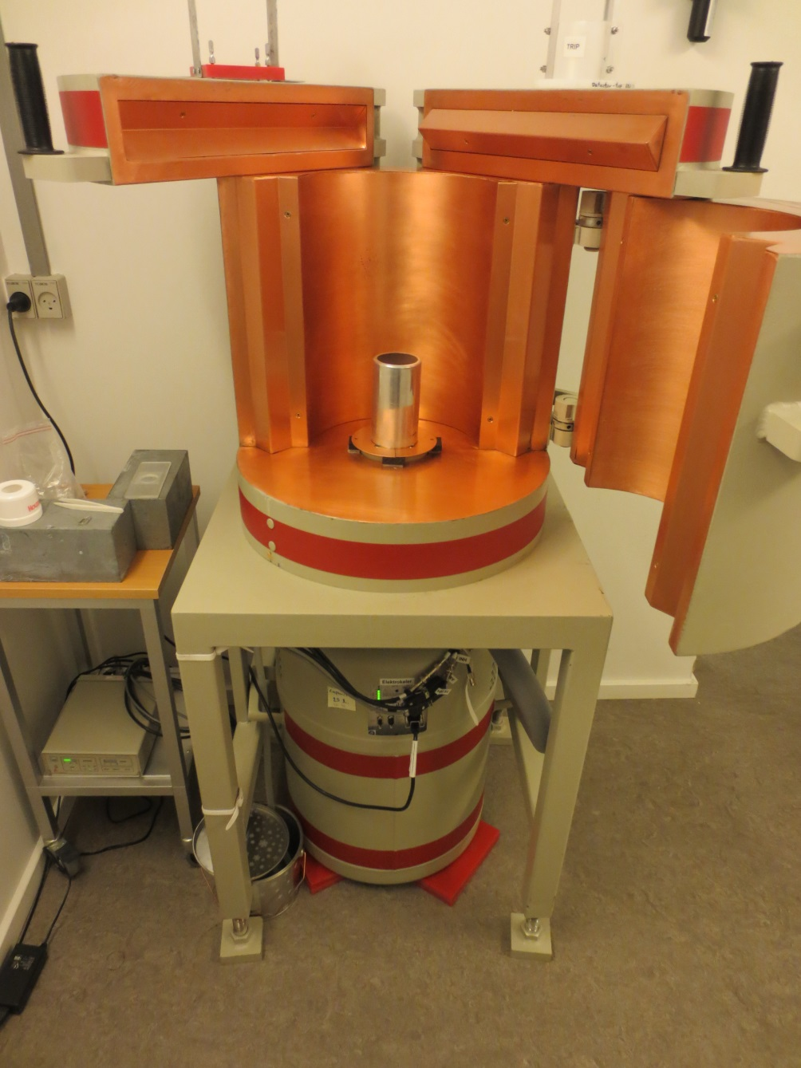
Setup:
Characterized Ge detector
Electrical cooling
Shielded lab + 10 cm Pb.
No background peaks
except 511 keV

Slide 3
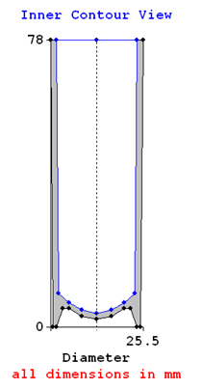
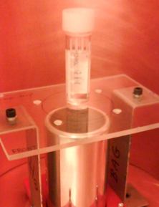
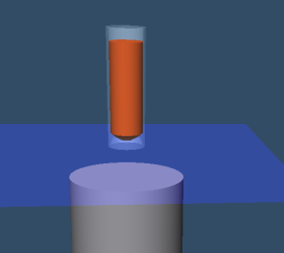
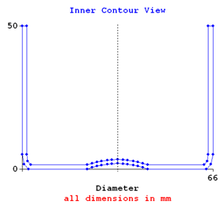
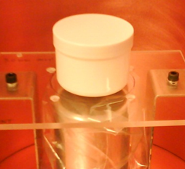
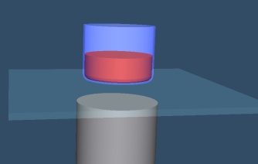
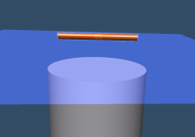
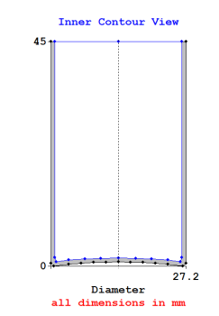
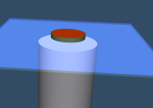
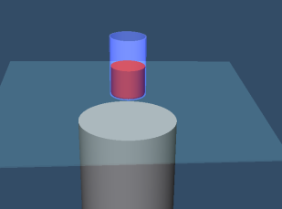
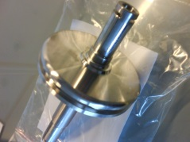
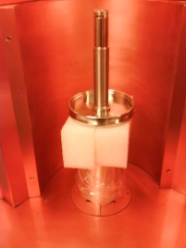
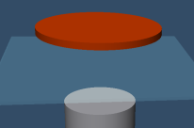
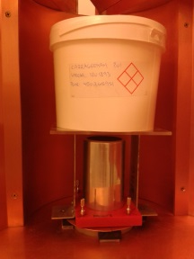
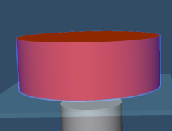

Slide 4
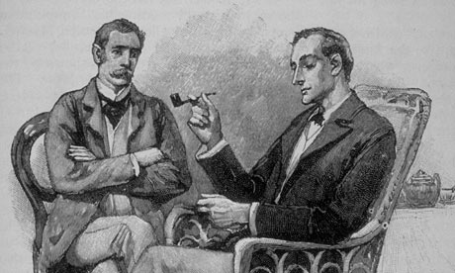
Can You prove it?
It is so…
Notes:
QA objectives:
Minimized manual data handling (typing) – less QC work.
All entries and selections needed for reproduction must be recorded in a secure way
(time stamped and locked)
Either specific values or references to QA documentation (e.g. standard geometry)
Customized report output integrating system validation info. Optimized for QC.

Slide 5
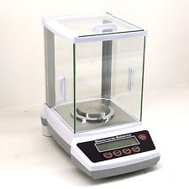
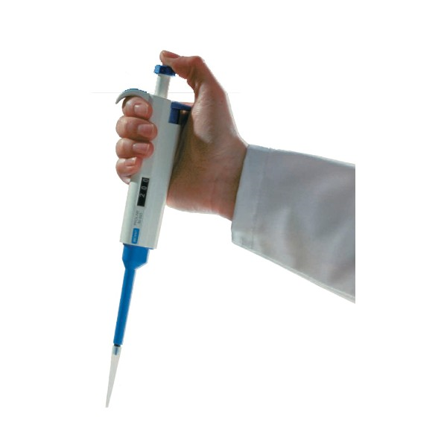
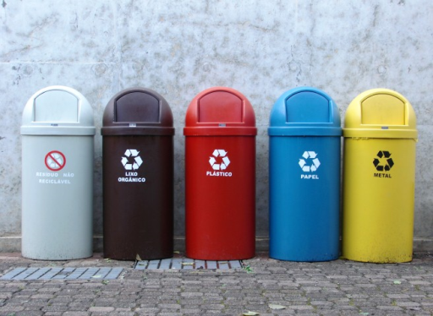
Human factor

Slide 6
To reproduce the analysis, I need:

Slide 7
Library Editor
Nuclides
t½
keV
yield
uncertainty
Acquisition
Date
PC clock
.NLB
File name
Sample ID
Ref date
Vol, mass
Uncertainty
Genie2K
Library
.TXT
Cascade
summing
correction
Geometry Composer
Energy &
uncertainty
list
.GEO
HV
Gain
Stabilizer
Filter
Calibration
.CAL
File name
Dimensions
Materials
Densities
Live time
Algorithm settings
.ECC
Report
template
Detector SN
Template
Beaker
.PDF
.CTF
Data report
.CNF
.RPT
.TPL
Nuclides
t½
keV
yield
uncertainty
Certificate Editor
.BKR
.PAR
Report
Viewer
File name
.PDF
Detector
characteri-
zation
Dimensions
Materials
Beaker
Editor
Final report
Validation
parameters
QA Log
Test results
Sample Container
Manual entry
Non-editable software
Manuel selection
File
Transfer
Editable spreadsheet

Slide 8
Gammaspec 2016 sample
9,1698 (10) g
Fill-height ≈ 5 mm
Spectrum data file: GEC-987-K1-….cnf
Detector ID – Measurement ID – Acquisition cycle -

Slide 9
Geometry
Unique name: GEC-987_PLEXWHI
WHI: Sample container ID
PLEX: Holder ID, absorber
GEC-987: Detector and measurement ID
Name is used for .GEO, .CAL,

Slide 10
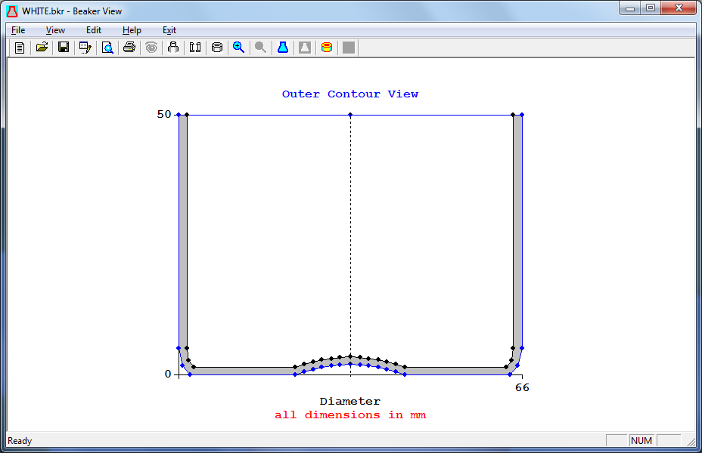
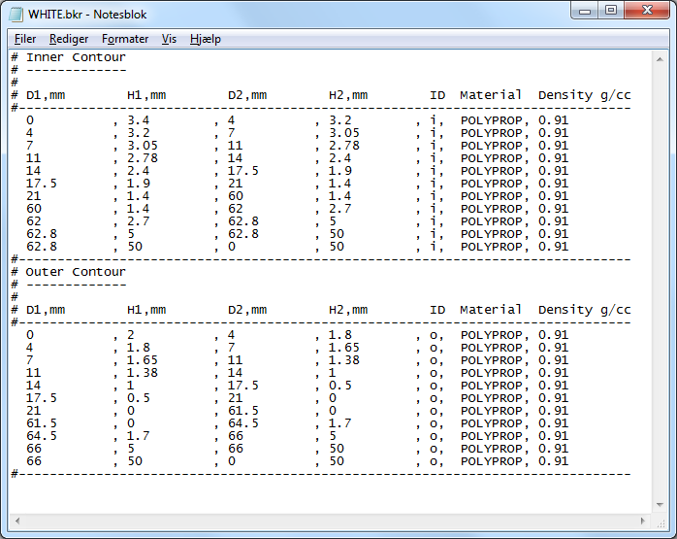
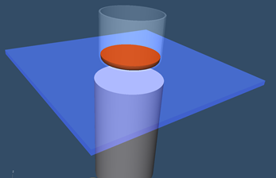
Geometry model (LabSocs)
Standard container ”WHITE.bkr”

Slide 11
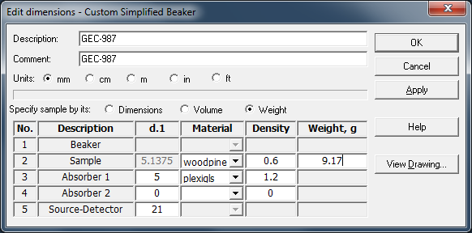
1. Assumed sample composition and weight entered
2. Density roughly adjusted to reach approx. fill-height

Slide 12
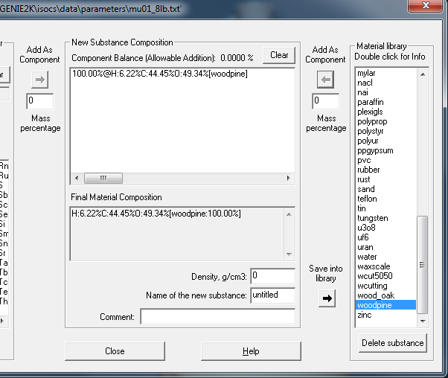
Screenshots for documentation
Density automatically
calculated from
sample mass and fill height

Slide 13
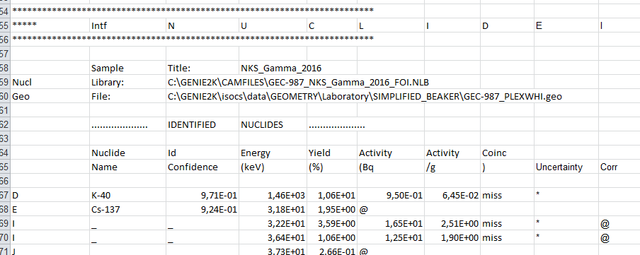
Genie report template (.tpl)
Section tag
“miss”, * and @ are moved to the end

Slide 14
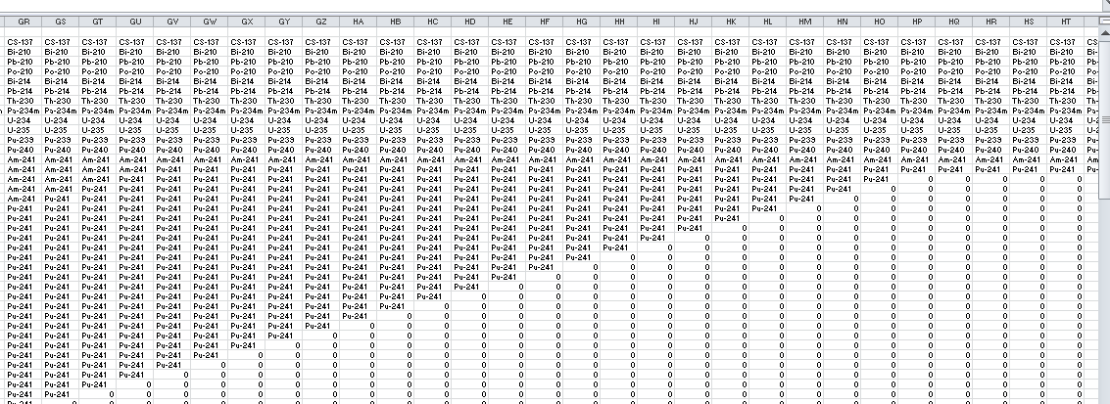
Nuclides listed with gaps!
Excel challenge…

Slide 15
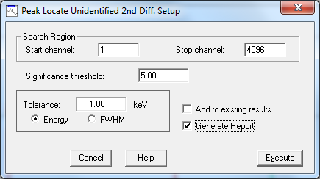
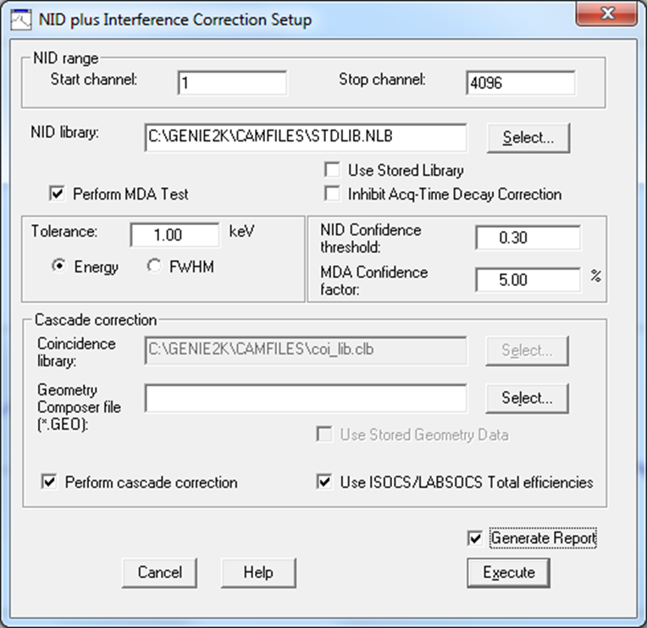
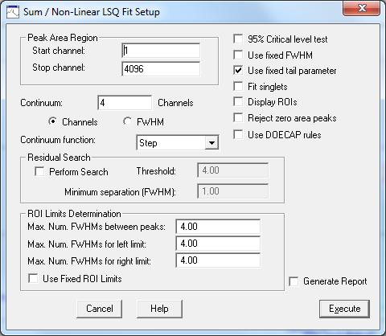
Genie algorithm settings

Slide 16
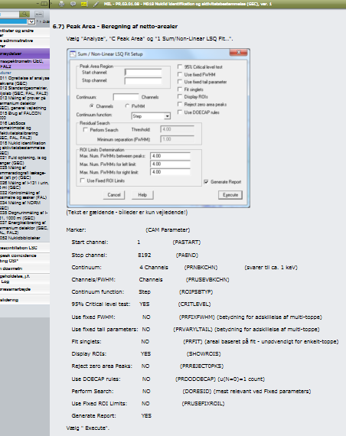
QA
Documentation

Slide 17
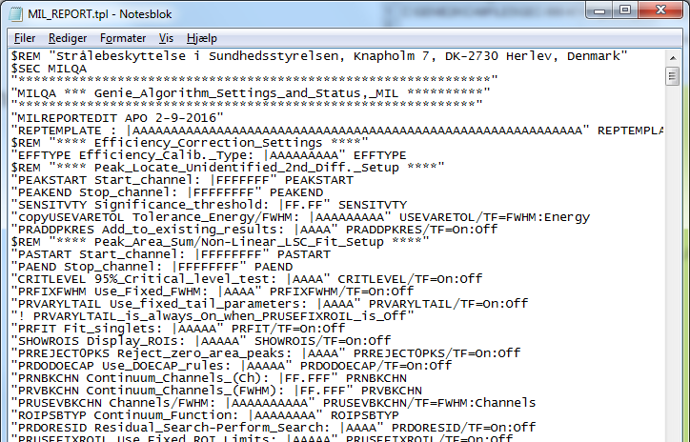
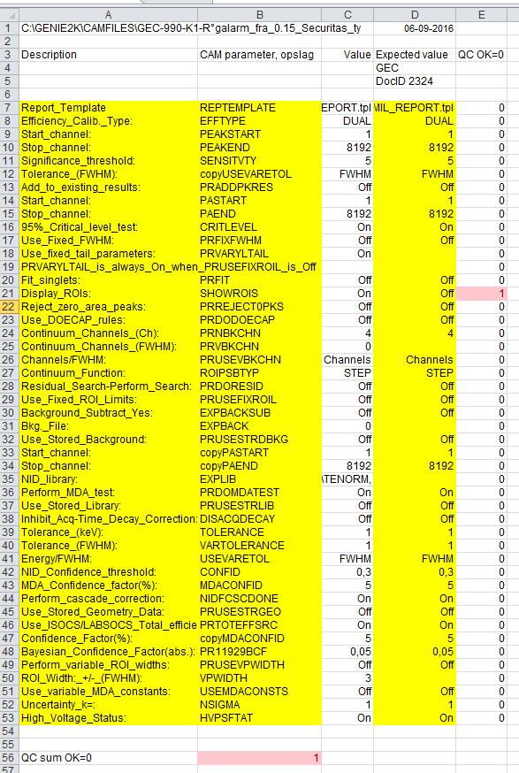
Genie algorithm settings QC
CAM-file parameter checksum

Slide 18
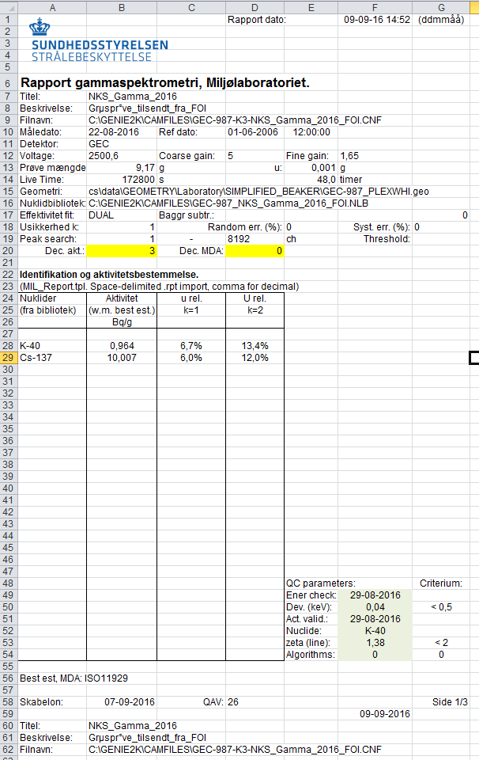
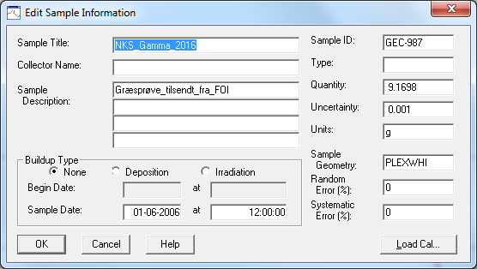
Final Report

Slide 19
Reporting rule
no
A (w.m.) > MDA ?
“ A < [MDA]”
yes
“ A (best est.) +/- u (best est.)”
To avoid false positive results, we have chosen not to report A when
MSA < A < MDA.
In some cases, w.m. < 0 and best. est. > 0.
w.m. = weighted mean
best. est. = best estimate (ISO11929)

Slide 20
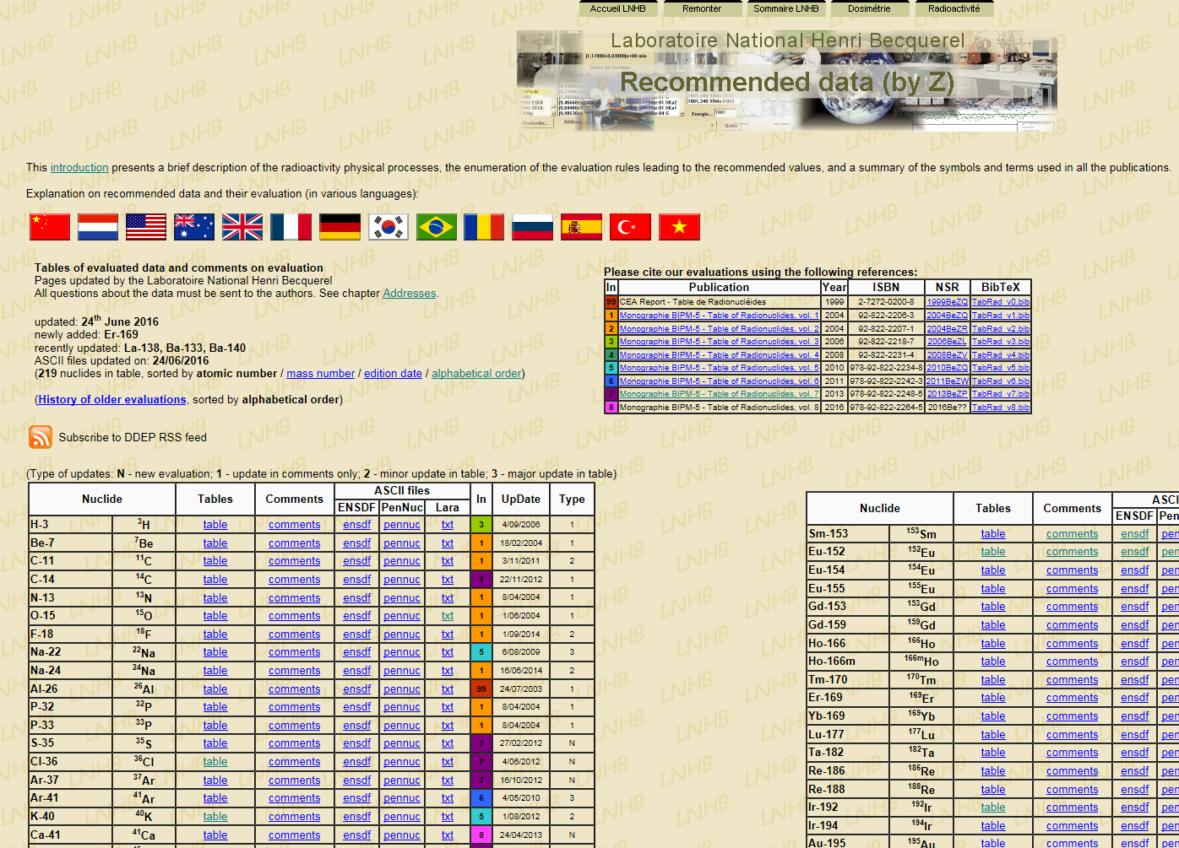
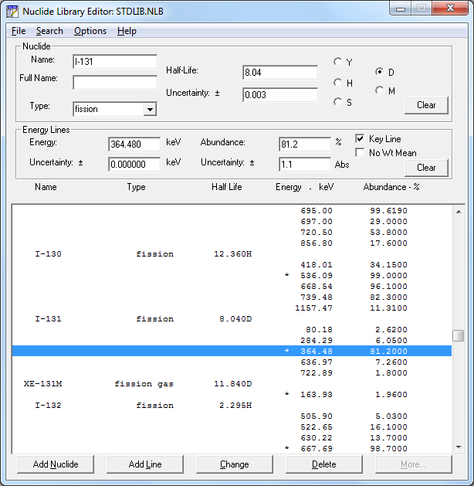
Loose end - Nuclide libraries
Data transfer?
Best data source?

Slide 21
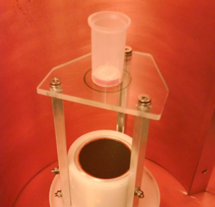
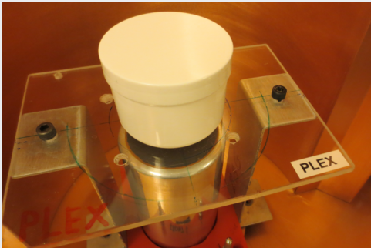
System validation
“Beaker”
Eu-152
“Point”
Cs-137, Co-60, Am-241 (Ra-226, Pb-210)
“Custom Beaker”
K-40 (KCl)

Slide 22
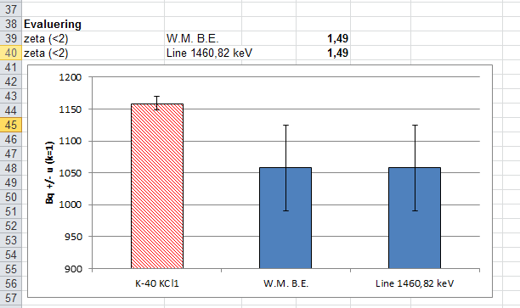
QC parameter
$$zeta=\frac{abs(A_{cert}−A_{obs})}{\sqrt{{u(A_{cert})}^{2}+{u(A_{obs})}^{2}}}$$

Slide 23
In case of non-compliance:
Increase efficiency uncertainty.
E.g. changed from factory default (4%)

Slide 24
QC parameter
Energy tolerance (Eu-152)
Maximal deviation (keV)

Slide 25
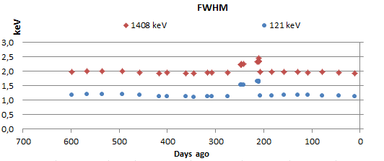
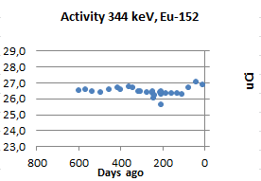
Drift
Energy sens.
Resolution
“Efficiency”

Slide 26
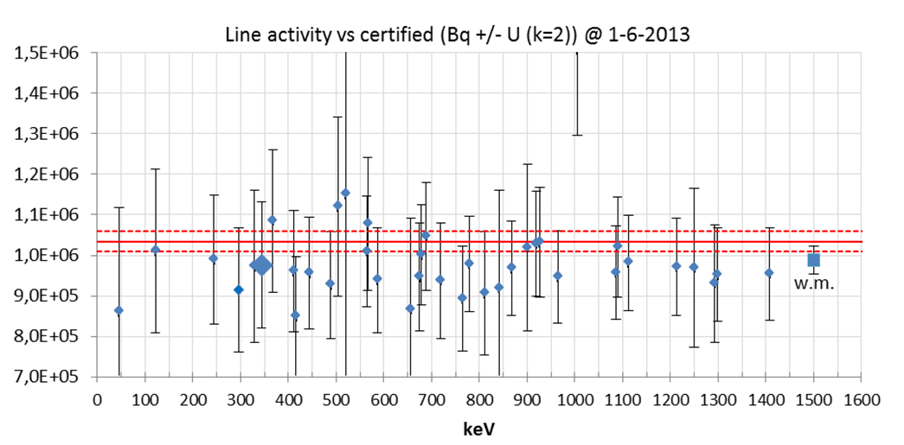
Eu-152 LACE

Slide 27
