Slide 1
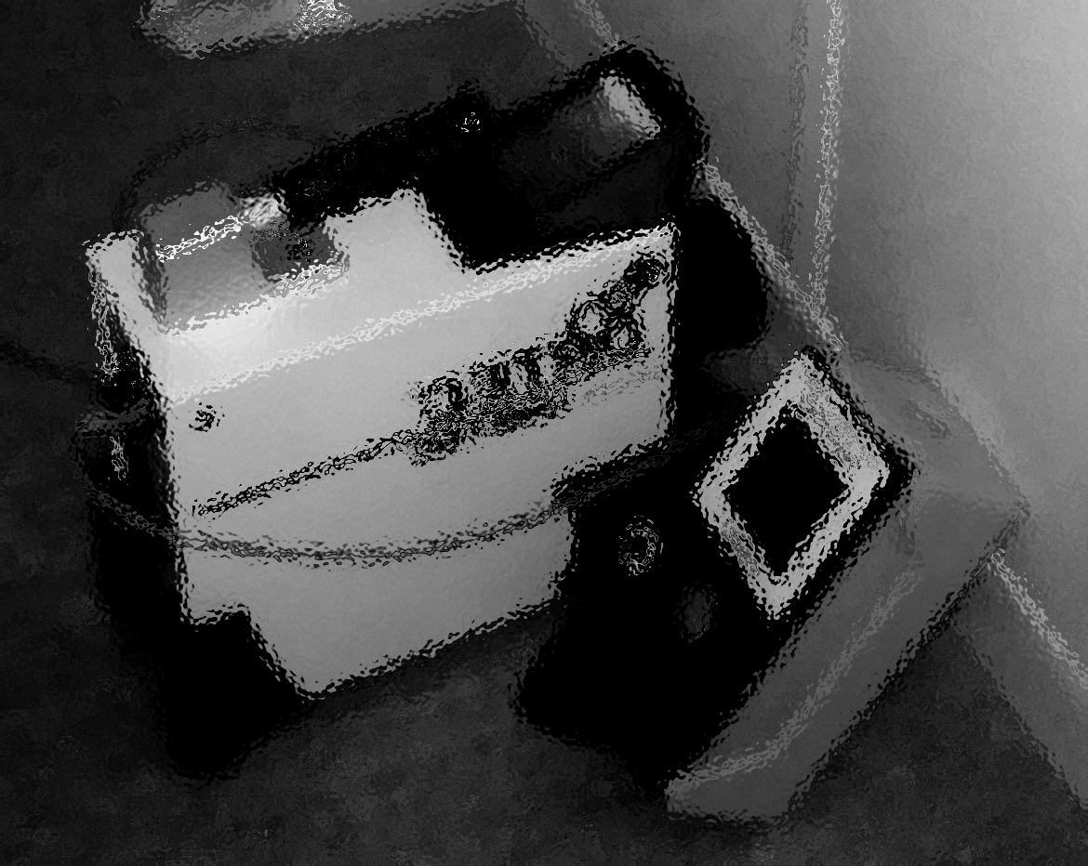
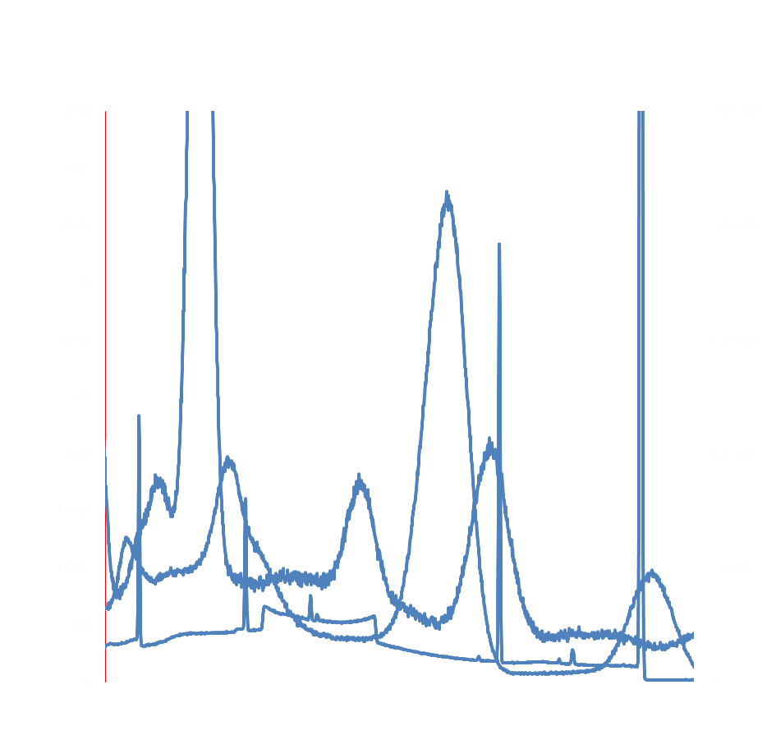
Sample measurement exercise (’PT’) Henrik Ramebäck Sofia Jonsson FOI Presentation@GAMMASPEC2016

Slide 2
’Measurement exercises’
What is your view of a measurement exercise, like a PT? (This is not an official PT though)
Is it something to avoid since there is a possibility that you ’fail’?
Is it an opportunity not only to show competence, but to pin-point possible problems in your measurement methods which then can be corrected?

Slide 3
Task
Measure the activity of radionuclides in a sample!
Only five laboratories participated!!!
Six results reported for the activity of ¹³⁷Cs [One lab reported two results: Different systems? Different locations?]
Two results reported for the activity of ⁴⁰K Considered as background?

Slide 4
The sample
IAEA-372, Radionuclides in grass:
⁴⁰K (1060±56) Bq, k=2 ¹³⁷Cs (11320±360) Bq, k=2
Reference date: 2006-06-01➔
Activity 2016-09-09: ⁴⁰K (1060±56) Bq, k=2 ¹³⁷Cs (8930±280) Bq, k=2

Slide 5
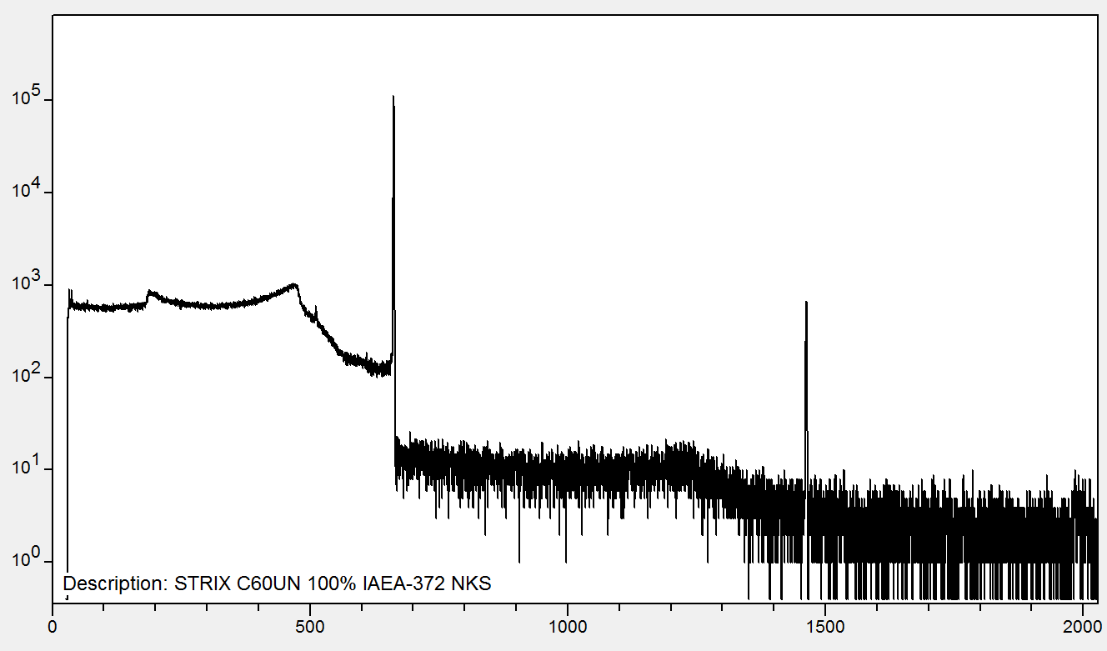
A spectrum
Measured 73 ks using a low-background HPGe:

Slide 6
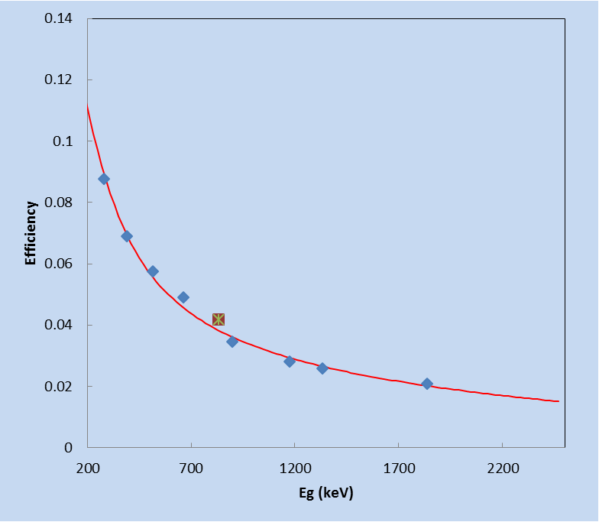
Possible difficulties
’Pure’ empirical calibration:
-Biased efficiencies in close geometries
at ’high’ energies ➔Possible problem for K-40!
-This results in biased effeciency also at lower energies: 7% at 662 keV in the
example ➔Possible problem for Cs-137!
Unfortunately, only two participants measured ⁴⁰K…
Biased efficiencies
due to TCS if measured in a
close geometry!

Slide 7
Reporting
Six labs reported ¹³⁷Cs
Two labs reported ⁴⁰K
Four labs stated the coverage factor!
Two labs did not state the coverage factor (or confidence interval)

Slide 8
Evaluation
Measurement results were evaluated using the ”ZETA-score”:
z<2: ”ok” [2<z<3: ”warning” z>3: ”not ok”]
For the two results not stating any coverage factor, the standard uncertainties were evaluated according to GUM assuming a rectangular distribution
$$ζ=\frac{x−X}{\sqrt{u_{x}^{2}−u_{X}^{2}}}$$

Slide 9
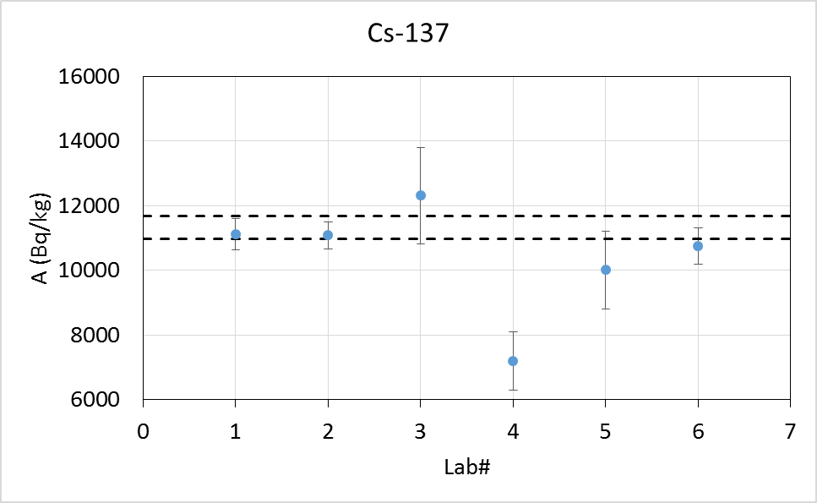
Results: ¹³⁷Cs
z=2.1
z=7.5

Slide 10
Results: ⁴⁰K
Both labs reporting ⁴⁰K were ok, i.e z<2!

Slide 11
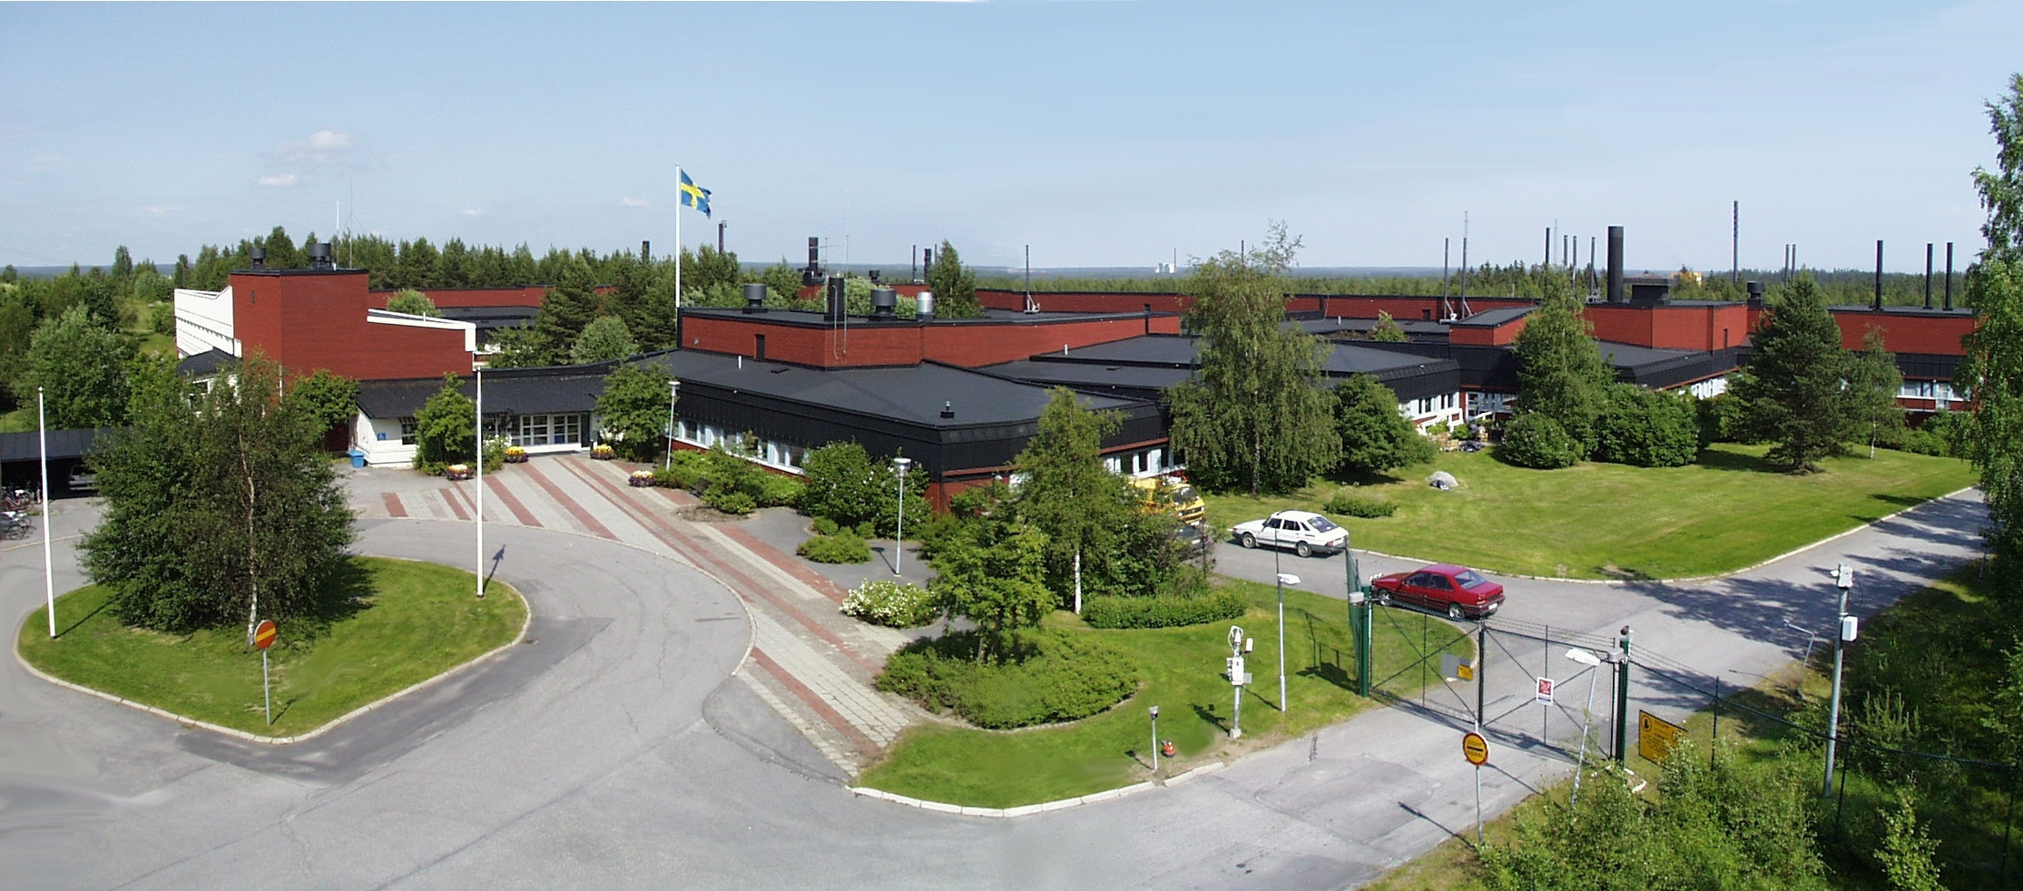
FOI CBRN Defence and Security, Umeå
?

